Slide 1
Color sensor
Here is where your presentation begins

Slide 2
Table of contents
01
02
03
04
Arduino UNO
Color Sensor
Arduino UNO is a microcontroller board based on the ATmega328P
A color sensor has color filters (Red, Green, and Blue)
Servo Motor
Jump Wire
A servomotor is a closed-loop servomechanism that uses position feedback
RF jumper cables - Jumper cables is a smaller and more bendable corrugated cable

Slide 3
Table of contents
01
02
03
04
Arduino UNO
Color Sensor
Arduino UNO is a microcontroller board based on the ATmega328P
A color sensor has color filters (Red, Green, and Blue)
Servo Motor
Jump Wire
A servomotor is a closed-loop servomechanism that uses position feedback
RF jumper cables - Jumper cables is a smaller and more bendable corrugated cable

Slide 4
01
Implementation of this project
You can describe the topic of the section here

Slide 5
The benefits of efficient color sorting
Efficient color sorting offers benefits such as enhanced quality control, increased productivity, waste reduction, cost savings, consistent product appearance, accurate quality assurance, optimized agricultural yield, improved customer satisfaction, streamlined manufacturing processes, and compliance with standards
Meet us

Slide 6
Priority scale of color sorting
Sorting Grains and Seeds
Waste Sorting
This facilitates the recycling process by ensuring that materials
Only high-quality seeds are planted, leading to better crop yields.
Labling and Branding
Pharmaceutical
Quality Control in Drug Manufacturing
color sorting is essential for ensuring that labels and packaging materials match brand colors.

Slide 7
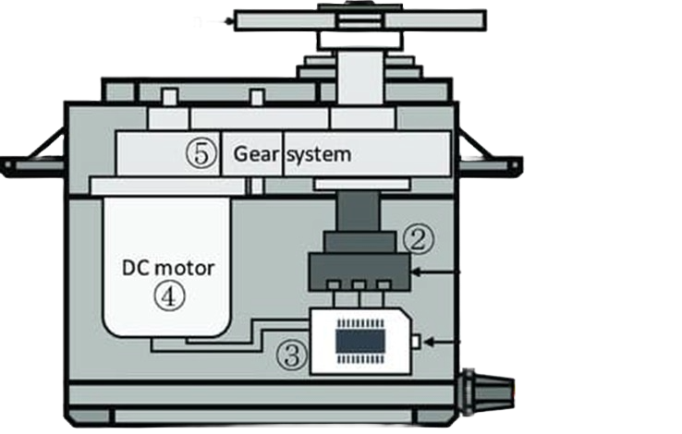
Servo Motor
Potentiometer
A potentiometer is a three-terminal resistor with a sliding or rotating contact
Embedded board
Basically, a ROM circuit works by accepting column and row address

Slide 8
What sets us apart?
Multi-Spectral Imaging
User-Friendly Interfaces
Real-Time Data Analytics
Implementing intuitive interfaces for operators, making it easier to configure and manage color sorting parameters.
Saturn is a gas giant and has several rings. It was named after the Roman god of wealth and agriculture
Using advanced sensors to analyze materials based on multiple wavelengths, allowing for more detailed and nuanced color distinctions.

Slide 9
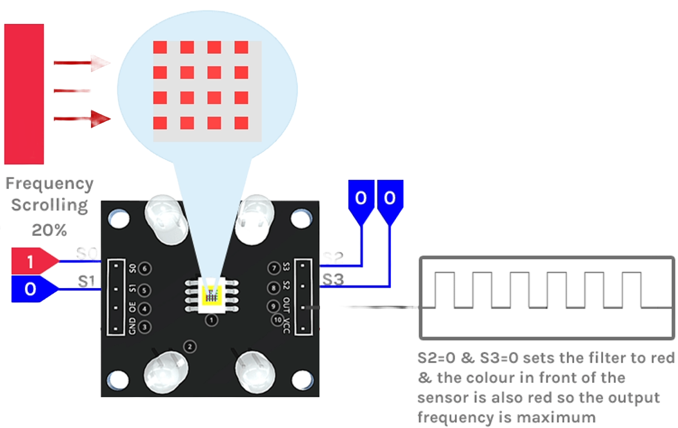
Servo Motor
Three filters with wavelength sensitivities at 580 nm, 540 nm, and 450nm to measure the wavelengths of red, green and blue colors respectively.
Color gread
The TSC3200 Color Sensor IC is an 8 pin IC with SOC package

Slide 10
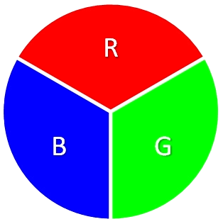
What do we offer?
20%
Red
Mercury is the very small
25%
Green
Venus has a beautiful name
55%
Blue
Earth is where we all live
It is Blue Color

Slide 11
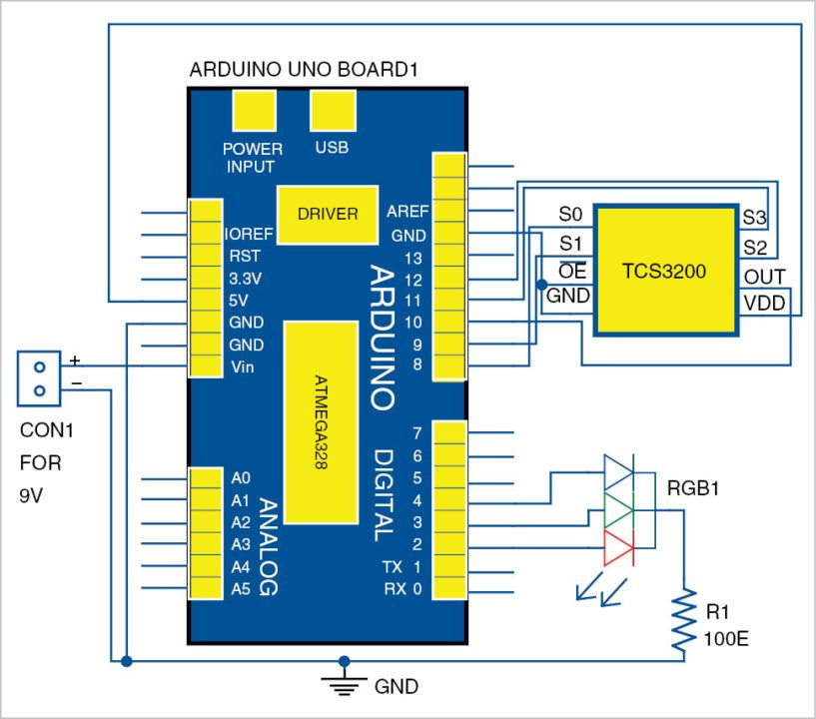
Achievement & Improvement
Revolutionizing color sorting, our innovative system achieves unparalleled accuracy and throughput, reducing waste and optimizing operations. With real-time monitoring, adaptability, and cost-effective automation, it outperforms existing methods, ensuring quality, sustainability, and enhanced user experience.

Slide 12
Alternative resources
Our color sorting project pioneers precision with innovative technology, setting new industry standards for efficiency and sustainability. Through user-focused design and scalability, it stands as a transformative force in the modern industrial landscape.
References:-
researchgate.net by Vijay malia

Slide 13
Thanking you Dwij Desai Saurin Patel Siddharth Sharma

